Slide 1
205 Sep 24, Class 4
Chapter 4, Experimental Procedure

Slide 2
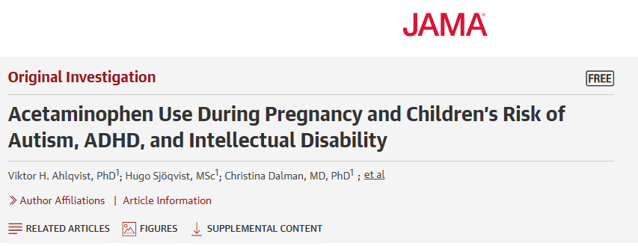
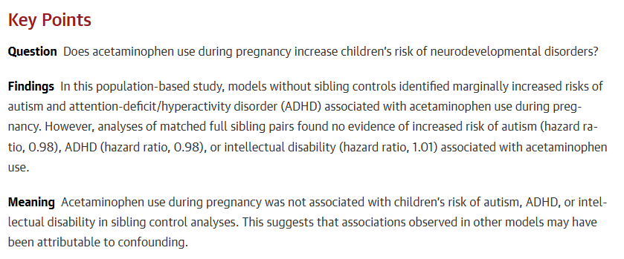

Slide 3
Abstract
Importance Several studies suggest that acetaminophen (paracetamol) use during pregnancy may increase risk of neurodevelopmental disorders in children. If true, this would have substantial implications for management of pain and fever during pregnancy.
Objective To examine the associations of acetaminophen use during pregnancy with children’s risk of autism, attention-deficit/hyperactivity disorder (ADHD), and intellectual disability.
Design, Setting, and Participants This nationwide cohort study with sibling control analysis included a population-based sample of 2 480 797 children born in 1995 to 2019 in Sweden, with follow-up through December 31, 2021.
Exposure Use of acetaminophen during pregnancy prospectively recorded from antenatal and prescription records.
Main Outcomes and Measures Autism, ADHD, and intellectual disability based on International Classification of Diseases, Ninth Revision and International Classification of Diseases, Tenth Revision codes in health registers.
https://jamanetwork.com/journals/jama/fullarticle/2817406

Slide 4
Results In total, 185 909 children (7.49%) were exposed to acetaminophen during pregnancy. Crude absolute risks at 10 years of age for those not exposed vs those exposed to acetaminophen were 1.33% vs 1.53% for autism, 2.46% vs 2.87% for ADHD, and 0.70% vs 0.82% for intellectual disability. In models without sibling control, ever-use vs no use of acetaminophen during pregnancy was associated with marginally increased risk of autism (hazard ratio [HR], 1.05 [95% CI, 1.02-1.08]; risk difference [RD] at 10 years of age, 0.09% [95% CI, −0.01% to 0.20%]), ADHD (HR, 1.07 [95% CI, 1.05-1.10]; RD, 0.21% [95% CI, 0.08%-0.34%]), and intellectual disability (HR, 1.05 [95% CI, 1.00-1.10]; RD, 0.04% [95% CI, −0.04% to 0.12%]). To address unobserved confounding, matched full sibling pairs were also analyzed. Sibling control analyses found no evidence that acetaminophen use during pregnancy was associated with autism (HR, 0.98 [95% CI, 0.93-1.04]; RD, 0.02% [95% CI, −0.14% to 0.18%]), ADHD (HR, 0.98 [95% CI, 0.94-1.02]; RD, −0.02% [95% CI, −0.21% to 0.15%]), or intellectual disability (HR, 1.01 [95% CI, 0.92-1.10]; RD, 0% [95% CI, −0.10% to 0.13%]). Similarly, there was no evidence of a dose-response pattern in sibling control analyses. For example, for autism, compared with no use of acetaminophen, persons with low (<25th percentile), medium (25th-75th percentile), and high (>75th percentile) mean daily acetaminophen use had HRs of 0.85, 0.96, and 0.88, respectively.
Conclusions and Relevance Acetaminophen use during pregnancy was not associated with children’s risk of autism, ADHD, or intellectual disability in sibling control analysis. This suggests that associations observed in other models may have been attributable to familial confounding.

Slide 5
Reading the research
Extraneous variables
  What other factors could lead to the observed association?
Samples
  Size and source
Statistics
  Effect sizes > p-values
    “was associated” is p<.05
    How strong was the association?
  Be wary of reports focused on changing rates
    Headlines particularly misleading

Slide 6
Implicit bias research
Bargh, Chen & Burrows (1996) found that activating stereotypical concepts led to direct changes in behavior
  Experiment 1: participants primed with the concept of rudeness interrupted the experimenter
  Experiment 2: participants primed with an elderly stereotype walked more slowly after the study

Slide 7
“Rude” Priming manipulation
Participants asked use the five words listed to construct a grammatically correct four-word sentence as quickly as possible.
  E.g., "he it hides finds instantly.“
  15 of the 30 items contained words related to the trait in question.
For the rude priming version, the critical priming stimuli were: aggressively, bold, rude, bother, disturb, intrude, annoyingly, interrupt, audaciously, brazen, impolitely, infringe, obnoxious, aggravating, and bluntly
For the polite priming version, the stimuli were: respect, honor, considerate, appreciate, patiently, cordially, yield, polite, cautiously, courteous, graciously, sensitively, discreetly, behaved, and unobtrusively

Slide 8
Dependent variable
Participants told to come find the experimenter down the hall after completing the 5m sentence construction test
Experimenter and confederate pre-arranged to be in conversation when the participant emerged
  Stopwatch started
Conversation continued until participant interrupted (10 min max)
  Waiting time measured
  Rude condition, M = 326 s
  Polite condition, M = 558 s

Slide 9
Walking speed
Priming is sentence construction with words related to elderly/aging
Walking speed down a hallway measured after priming task
  Bargh, Chen & Burrows (1996) found slower walking measured with stopwatch by experimenter
  Doyen, Klein, Pichon & Cleeremans (2012) found no effect with automatic timing measure (sensors)
  Further found that with stopwatches, the effect depended on research assistant training knowing the hypothesis (or reversed)
    Implicit bias in experimenters
“Rosenthal effect”
  Implicit experimenter bias influencing the dependent measure

Slide 10
Avoiding experimenter bias
Use automatic measures whenever possible
  Reaction time measures depend on accurate start/stop signals
Avoid interacting with participants while dependent measures are collected
Plan for possibly ambiguous responses
  Misspellings
  Misunderstanding instructions
  Scripted scoring systems

Slide 11
Demand characteristics
Participants will (sometimes) try to give you the answer they think you want to hear
  Accidental bias can happen from experimenter encouragement
Participants are usually kept “blind” to the hypothesis or design
  As in Experiment 1
  You didn’t know if you were in the condition supposed to produce better memory
Wording of assessment questions chosen carefully
  Kept constant across conditions wherever possible
  Chapter 14 will discuss avoiding biased wording

Slide 12
Double Blind studies
The experimenters do not know the condition of the IV
  Requires external support to prepare research materials
Common in medical intervention research, e.g., drug studies
  Research pharmacy prepares numbered doses
  Conditions only revealed after data collection complete
  Randomized Clinical Trials (RCT)
Unusual in experimental psychological research

Slide 13
Independent raters
When subjective judgments are required, use “independent raters”
  Research assistants kept blind to condition
  Experimenters know the research hypothesis, but personnel carrying out scoring do not
Examples
  Emotional reactions such as laughing
  Playground aggression
  Speech performance after anxiety treatment

Slide 14
Homework
Read the brief summary of the following study: “Participants drank either coffee or tea before taking a cognitive test. The coffee group performed significantly better.” What potential confounds should the researcher consider?
You are doing a study at a local school. Because of the way things area scheduled, you can have one small testing room in the morning and another much larger testing room in the afternoon. If you have two treatment conditions (A and B), how can you assign subjects to the testing rooms so that the type of room will not lead to confounding your experiment?

Slide 15
Random assignment
Participant variables are not a problem for experimental design if random assignment is used
  Any unbiased process for assignment works
    ABAB will be random and keep group sizes similar
  Picking the condition may not be unbiased

Slide 16
Confederates
Some research may use research personnel acting as other participants
Procedure needs to be thoroughly and carefully scripted
  E.g., conversing until interrupted
  Acting experience a plus
Extraneous variables to consider
  Differences among confederates
  Consistency of protocol
  Fatigue in personnel

Slide 17
For Friday
Chapter 5, Sampling, Qs. 1-6
  Recruiting participants

